Slide 1
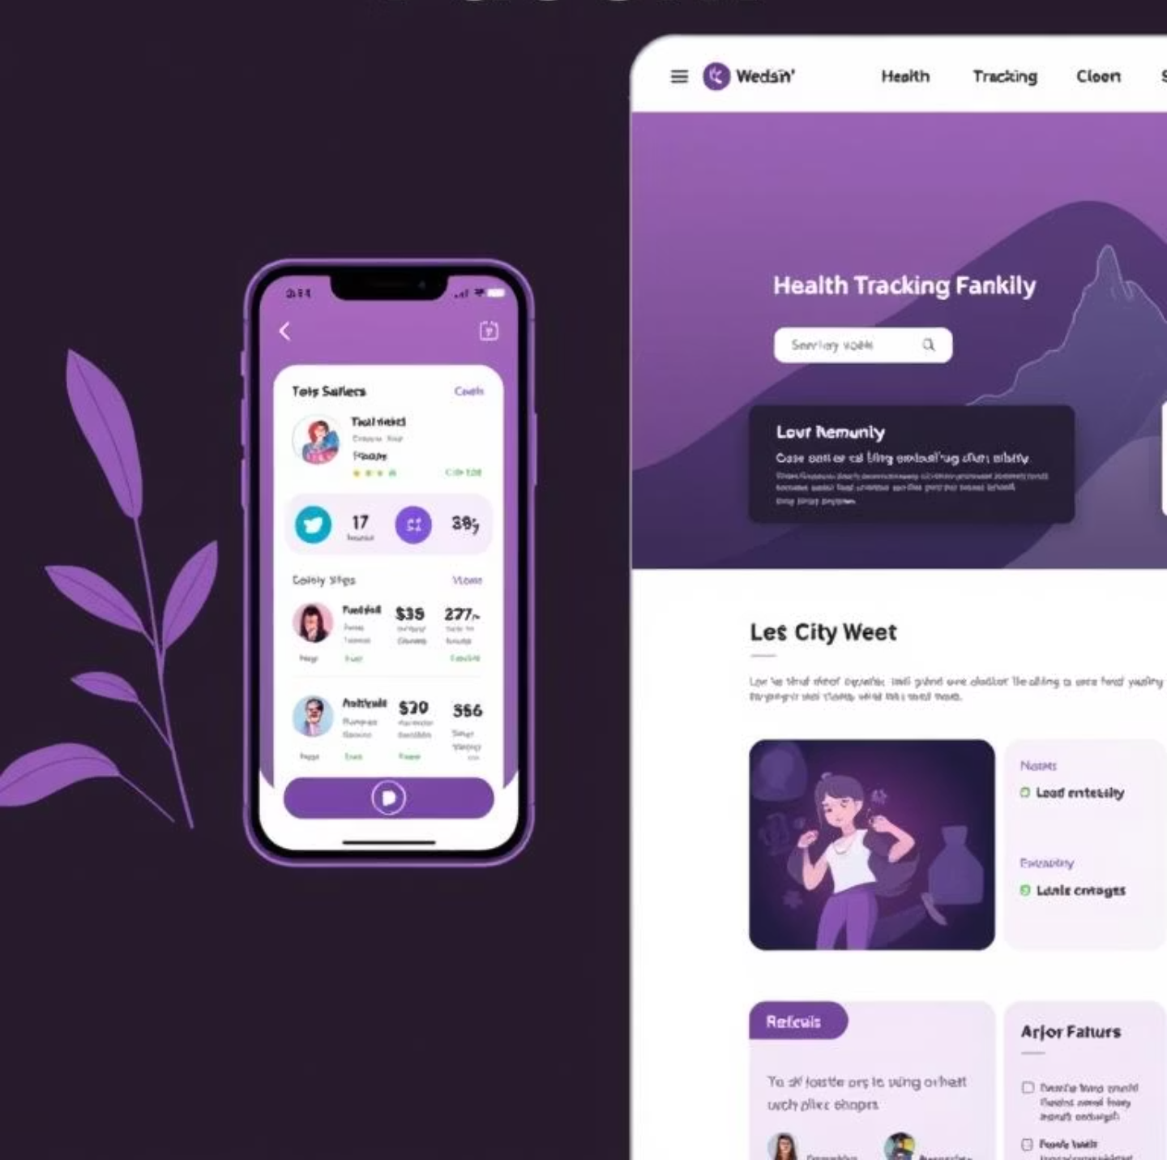
WellHub
(AI-Powered Corporate Wellness Platform)
Gamification + AI Powered + Community Engagement

Slide 2

The Problem
Lack of Motivation
Engagement Challenges
Employees often lack motivation to participate in wellness activities, leading to sedentary lifestyles and health issues.
Companies struggle to engage teams in healthy activities consistently, resulting in low participation rates.
Cultural Weakness
Low morale and weak workplace culture create barriers to wellness program adoption and sustainability.

Slide 3
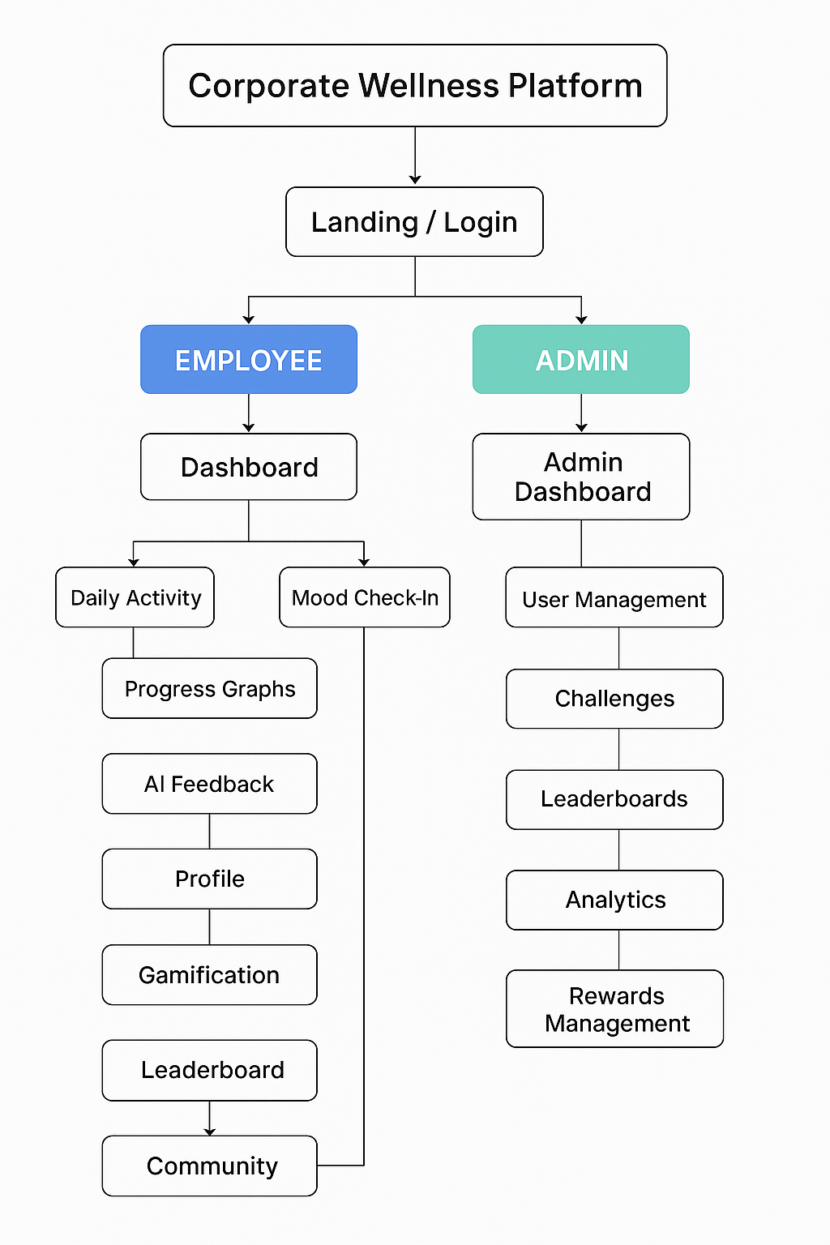
Our Solution
An AI-powered platform that transforms corporate wellness through personalized experiences and engaging features.
For Employees
For Admins
Mobile app for on-the-go access
Web dashboard with analytics
Personalized AI coaching
Challenge management tools
Gamification and rewards
Employee progress tracking
Community engagement
Reward distribution system

Slide 4
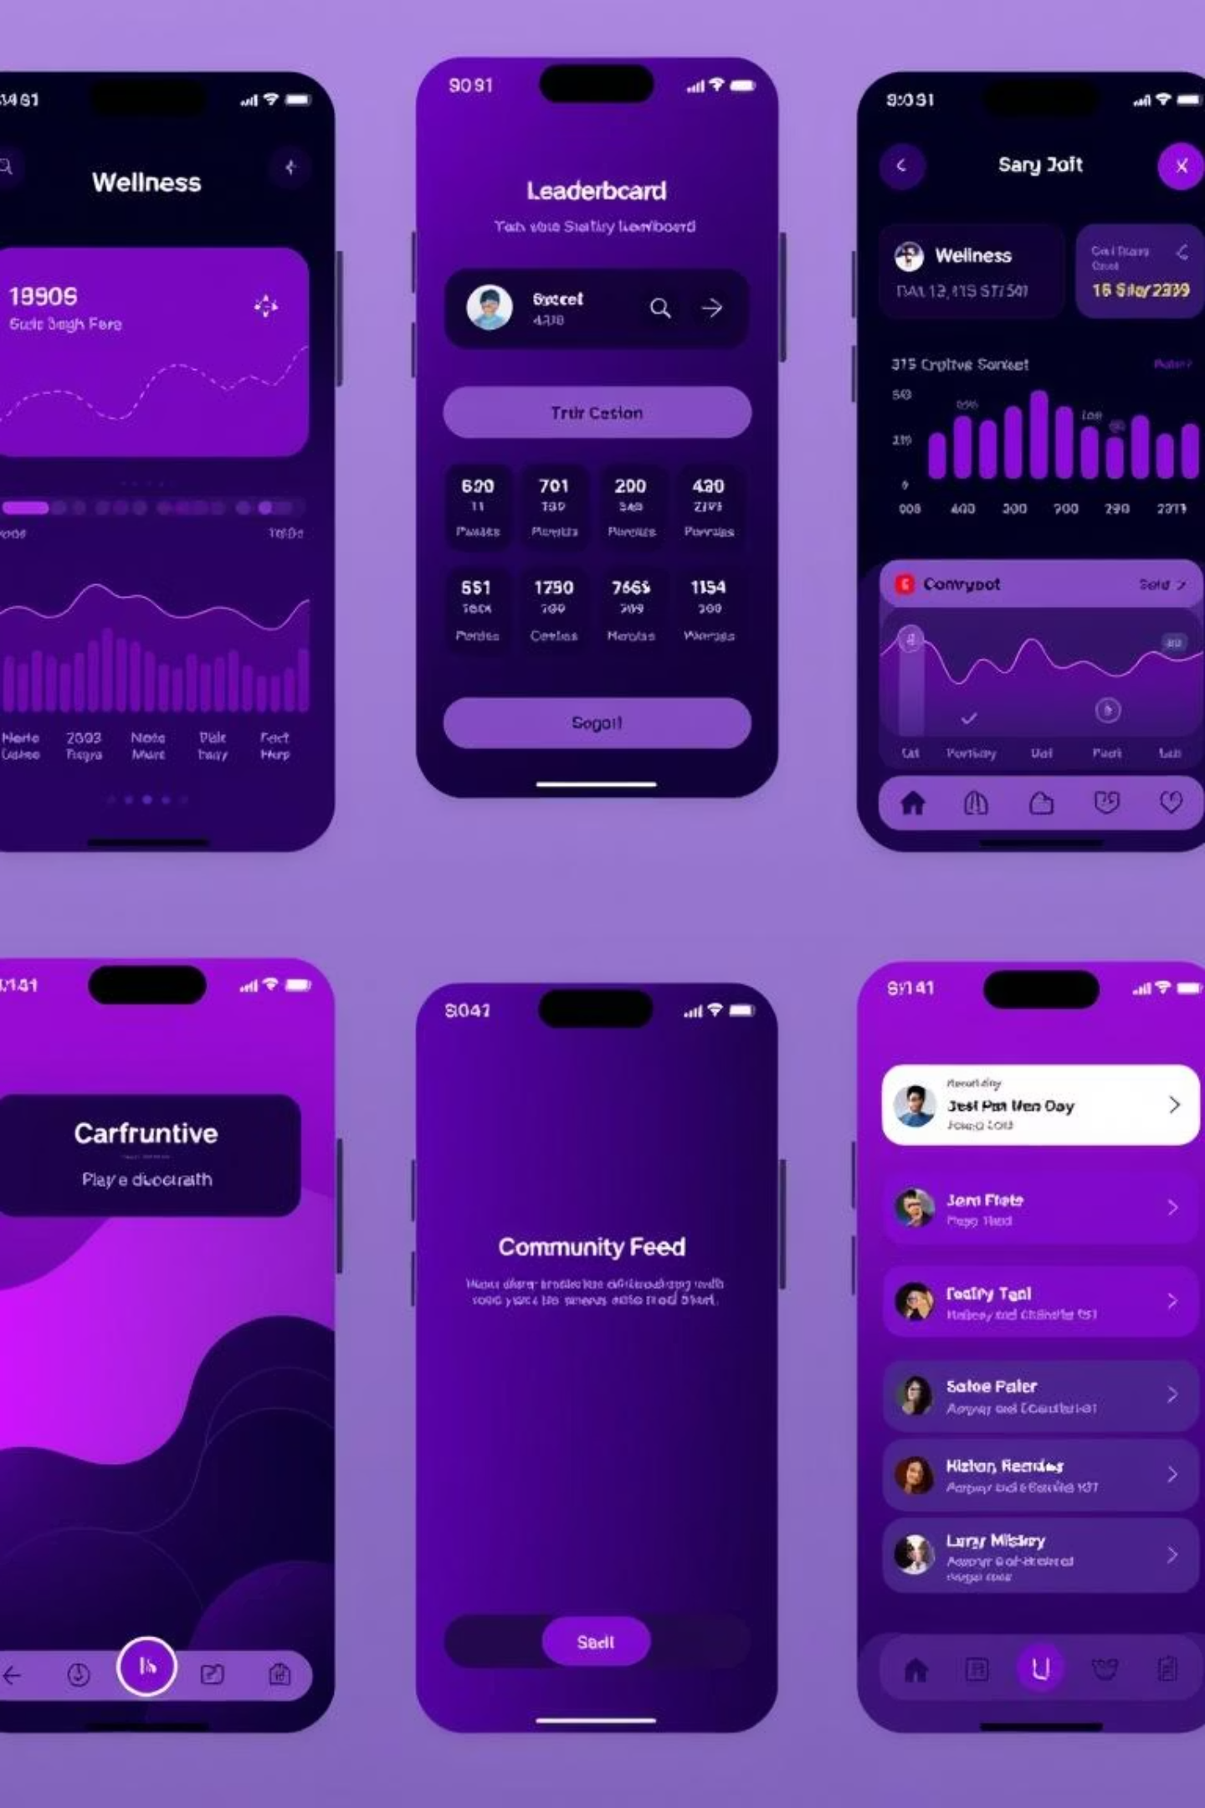




Employee Mobile App Features
Dashboard & Profile
Personalized dashboard with progress charts and account management features.
Gamification & Leaderboard
Earn badges, rewards, and prizes while competing on leaderboards for activities like steps walked.
Community
Connect with colleagues, join challenges, and share achievements through social engagement features.
AI Features
AI chatbot for wellness queries, personalized feedback, and GPS-based walking reminders.

Slide 5
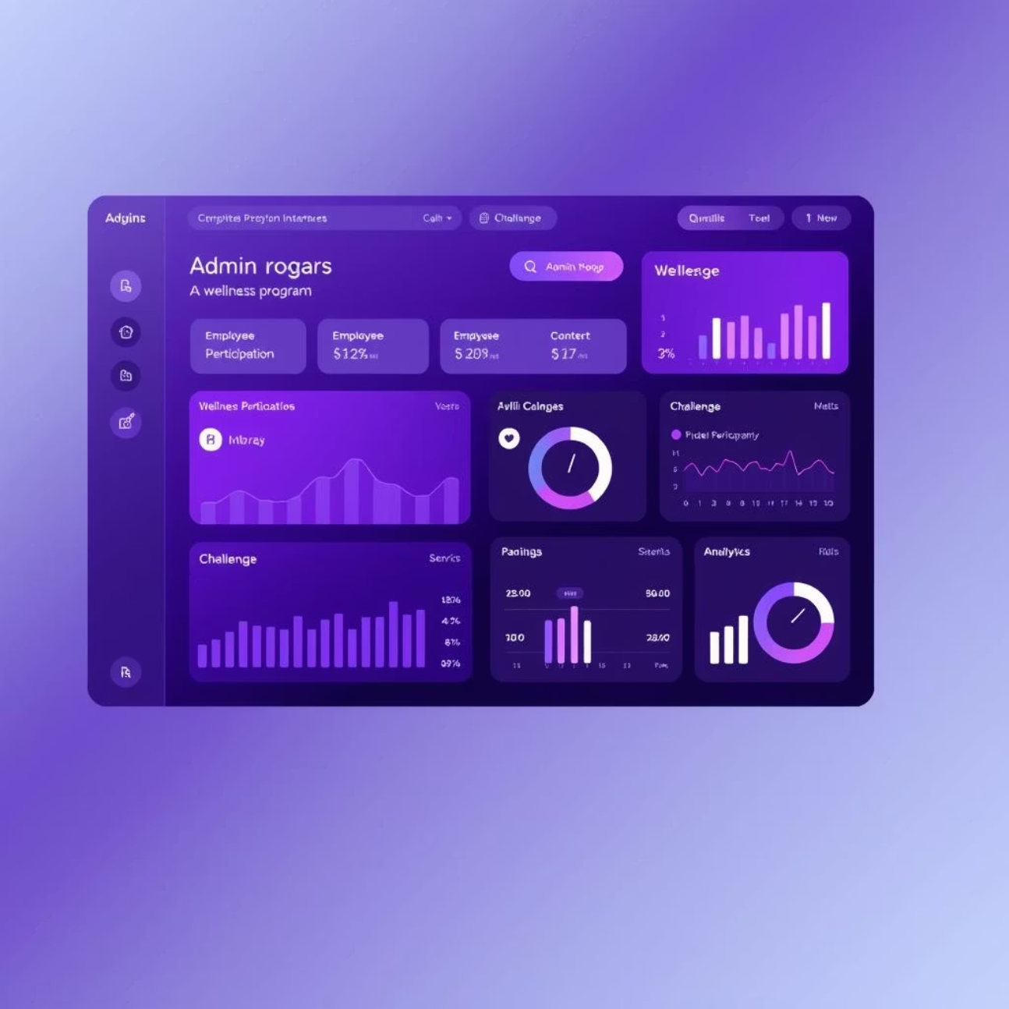
Website Features (Admin + Employee)
Employee Features
Dashboard with detailed charts
Profile management
Leaderboard access
Community engagement
Admin Tools
Challenge creation and management
Comprehensive analytics dashboard
Employee reward distribution
Program effectiveness metrics

Slide 6
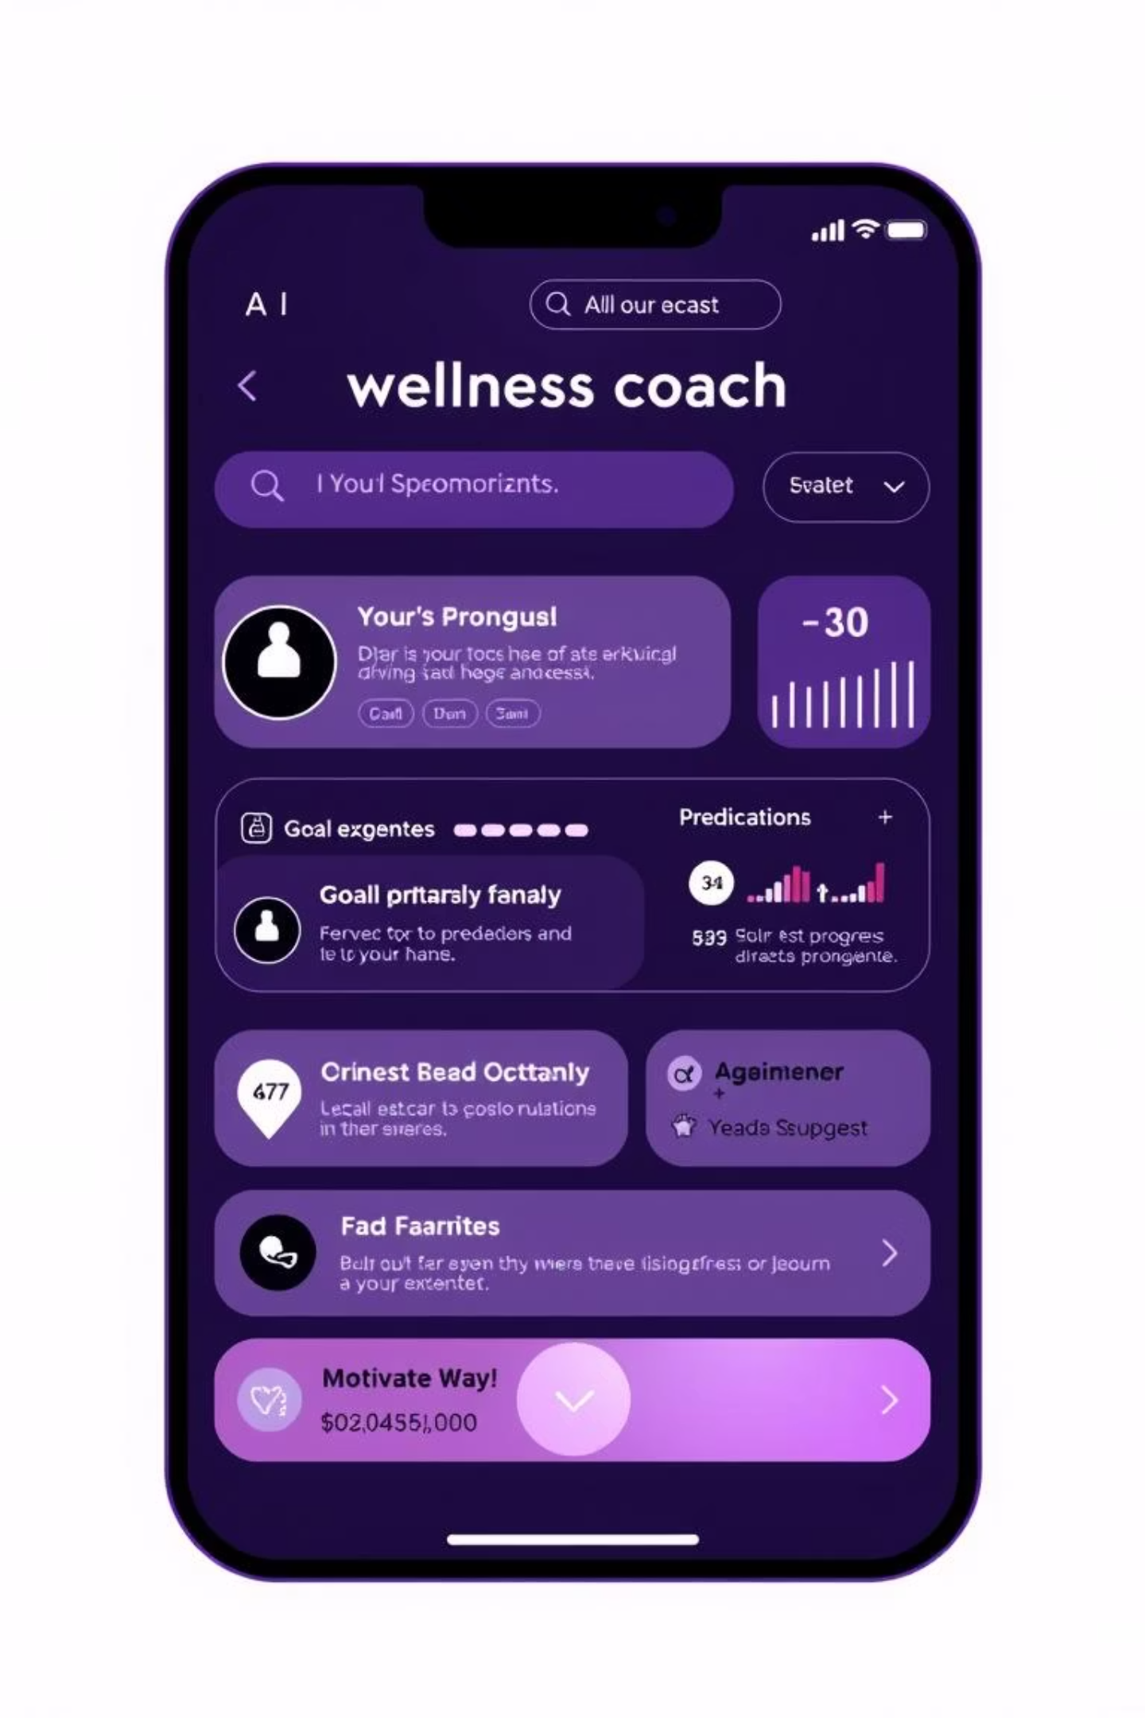



AI-Powered Features
Our platform leverages artificial intelligence to create personalized wellness experiences that adapt to each employee's needs and behaviors.
Smart Goal Setting
AI suggests personalized goals based on employee activity patterns and capabilities.
Progress Predictions
Weekly forecasts help employees visualize potential achievements and stay motivated.
Adaptive Coaching
Motivational messages, health tips, and personalized feedback through AI chatbot.

Slide 7
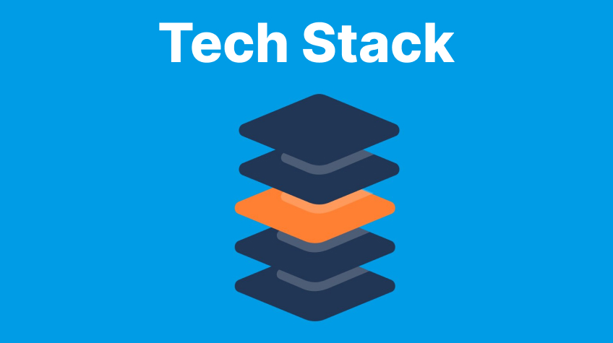
Tech Stack
Frontend: React / React Native (for web & mobile)
Backend: Node.js / Express
Database: MongoDB / PostgreSQL
APIs: Wearables API, HR data API, Gamification API
AI/ML: Python (scikit-learn, TensorFlow/PyTorch for models)
Visualization: D3.js / Recharts for analytics dashboards

Slide 8
Unique Differentiators
What sets our platform apart from traditional corporate wellness programs:
AI Personalization
Gamification System
Tailored wellness experiences for each employee based on their unique patterns, preferences, and goals.
Engaging badges, team challenges, and tangible rewards that drive consistent participation and friendly competition.
Community Focus
Admin Insights
Social features that foster connection, support, and accountability among colleagues.
Powerful analytics and actionable insights for HR to measure program effectiveness and ROI.

Slide 9
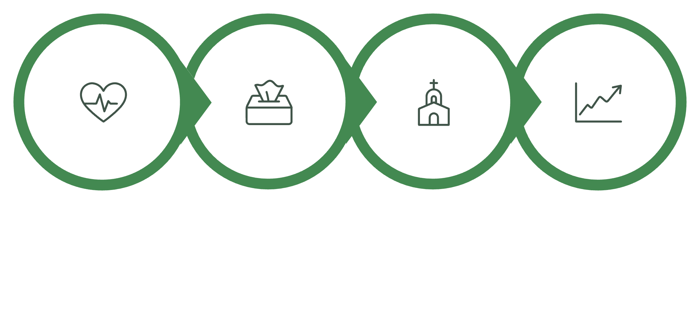
Impact & Future Scope
Current Impact
Future Scope
Boosts employee morale & physical health
Integration with wearables (Fitbit, Google Fit)
Improves workplace culture & engagement
AI-powered diet and stress management
Encourages teamwork through challenges
Advanced HR data integration
Scalable for any corporate environment
Individual Health
Team Engagement
Department Culture
Organization Impact

Slide 10
Thank You!

